Slide 1
Health Care Re-admission Prediction
Noman Mahmood

Slide 2
Exploratory Data Analysis
Empi - Patient Identifier
Visit-id : Admission ID
Visit_start_date: Admission Date
Visit_End _date : Release date
Visit_amount: Cost
PD (Primary Diagnosis): Disease code - ICD Codes - https://provider.amerigroup.com/docs/gpp/ALL_CARE_CMSHCCRAModel.pdf?v=202111081831
Drg_code: Standardized Hierarchy for cost management –
https://www.aapc.com/codes/drg-codes - range/2/60
Year /Month - Admission Timelines
DOB: Patient Age (Calculate with Year column) - Age in years
Gender - Patient Gender
State- Region in US

Slide 3
Exploratory Data Analysis
Race- Patient category
Elixhauser Comorbidities : Column N - AL - http://mchp-appserv.cpe.umanitoba.ca/viewConcept.php?printer=Y&conceptID=1436#:~:text=The%20Elixhauser%20Comorbidity%20Index%20is,present%20or%20it%20is%20not
Taxonomy_name : Different Categories of Medicines
Enumeration Date: Date of taxonomy
Length_of_stay: duration of admission
drg_los - a score based upon standard score on drg length of stay
ddc_category - Type of admission
Previous Date: Represent how frequent the patient is visiting the hospital , Should not be exceeding more than a year
Admission_interval : Days between two admission , if it is first admission than it takes 365 days
Unplanned_flag: If the admission is planned then we will ignore
CCI Score: https://www.mdcalc.com/charlson-comorbidity-index-cci
Lace Score: risk scores - https://www.ncbi.nlm.nih.gov/pmc/articles/PMC5374974/#:~:text=The%20LACE%20index%20uses%20four,of%206%20months%20before%20admission%20

Slide 4
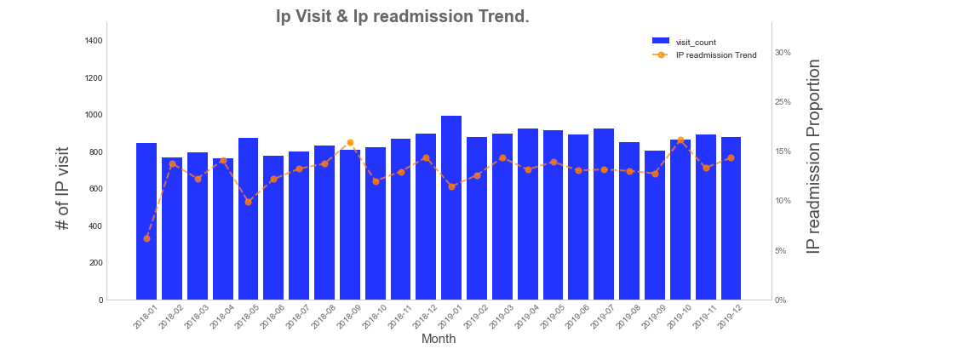
IP Trend Visualization

Slide 5
IP Trend Reflection
Observation
Total span of years is between Jan-18 to Dec- 19
About 850 visits per month are recorded on an averge
Overall average readmission proportion hovers between 13% - 14%
Some cyclic trend is observed but not guaranteed
Max readmission month is repetitive - may be because of year end

Slide 6
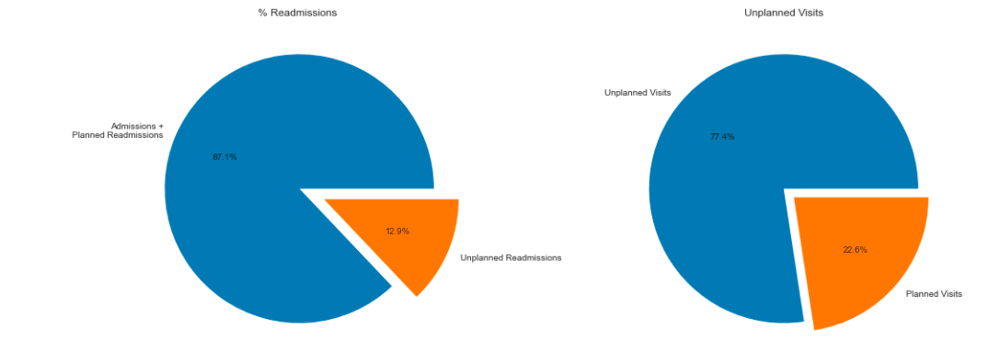
Scheduled Readmission vs Emergency Readmission

Slide 7
Official visit Reflection
Observation
About 13% of the total visits recorded as Unplanned readmission (remaining are either planned readmission or Admission )
77.5% which is 3/4th of the total visit are unplanned in nature

Slide 8
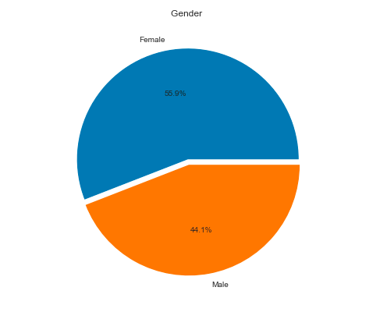
Patient Demographics

Slide 9
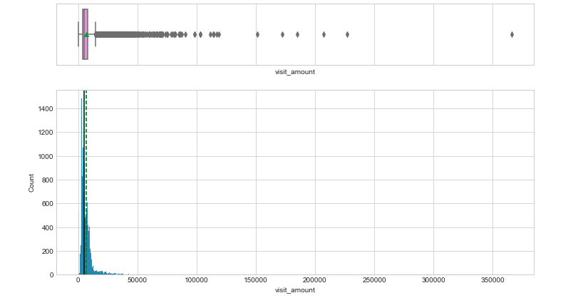
Univariate Outlier Analysis – Appointment

Slide 10
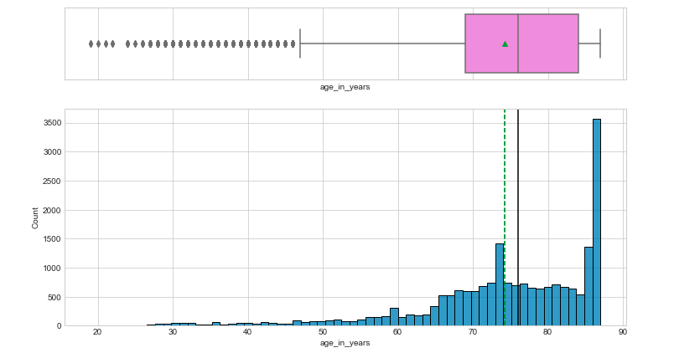
Univariate Outlier Analysis - Age

Slide 11
Official visit Reflection
Observation

Slide 12
Slide Title

